Slide 1
Database Planning, Design & Management
Lecture 2: File-Based Approach & DB History
By
NYANZI
2015

Slide 2
Course Outline
Introduction
Basic Concepts and Formal Definitions
DBMS Architecture, Data Modelling & SQL
Database Security & Integrity
Normalisation
Group Project Presentations

Slide 3
A File-Based Approach

Slide 4
Traditional File-Based Systems
Why study the file-based approach?
  Understanding problems inherent with file-based systems
  Understanding how file-based system works.
What is a File-Based System?
  A collection of programs that perform services for end-users where each program defines & manages its own data.
What motivated existence of File-Based Systems?
  Early attempts to computerise manual filing systems
  Demand by industry to have efficient data-access

Slide 5
Example of Manual File System
In any organisation it is common to open a paper file to hold external and internal correspondence relating to:
  Project
  Task
  Product
  Client
  Employee
  Etc
Every file has an index, date opened and date closed
How do you locate a document stored in a paper file, kept in a filing cabinet?

Slide 6
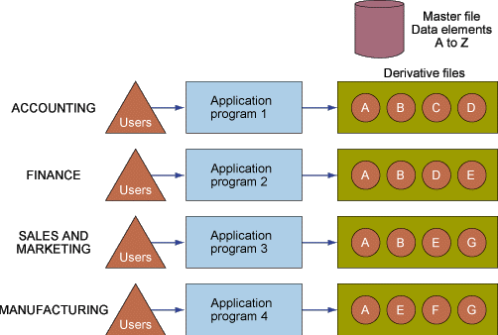
Organising Data in a File-Based Environment

Slide 7
Limitations of File-Based Systems [2]
Incompatible file formats
  File structure is dependent on the application program that generates it.
  e.g. VB generated file is incompatible with Java program
Fixed queries or proliferation of application programs
  Programmer writes code for generating fixed reports & queries.
  Lack of room for unplanned events or reports on new data patterns
Structural & data dependence
  Structural dependence: file access is dependent on file structure e.g Linux file system inaccessible to windows file system
  Data dependence: programs are changed if data characteristics (properties) change

Slide 8
Case-Study: MS Kasulu Property Masters
Organise yourselves in 4 groups
You have 10 minutes of group discussion
Every group is required to present its findings has 2 minutes to present its findings

Slide 9
Limitations of File-Based Systems [1]
Separation & isolation of data
  Data isolated in separate files is difficult to access due to file incompatibility
    e.g. report.sxc, report.foo, report.xls, report.btf, report.xsg are files generated by different programs
  e.g registry storing students grades for in each semester in separate files ..... DISASTROUS!!!
Duplication of data
  Wasteful in terms of time, effort & resources
    Who will communicate the changes in all affected departments?
    Who will effect updates in affected files?
  Loss of data integrity e.g.
    If a renter changes names how many files will be updated?

Slide 10
Limitations of File-Based Systems [3]
Lack of data sharing & availability
Lack of security

Slide 11
Adequacy of File-Based Systems
Number of Items stored is small
Number of items stored is large and items have to be stored and retrieved (NOT for processing or cross referencing)
Computer applications in file-based systems only automate clerical tasks (shop-floor activity) in a functional areas of a value chain

Slide 12
Lessons Learned from FBS
Limitations of FBS in data and information management is attributed to
  Lack of control over access & manipulation of data beyond imposition made by application programs
  Embedding data definition in application program but NOT separating data & programs
Database & Database Management Systems (DBMS) are designed to overcome above limitations

Slide 13
History of Database Systems

Slide 14
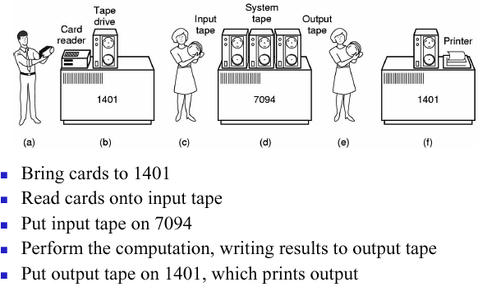
Database History – 1940s & 1950s [2]

Slide 15
Database History – 1940s & 1950s [2]
The 1st computers were huge batch processing systems
These computers could not communicate with each other
Computers were used as number crunchers
End users were scientifically & technically inclined e.g physicists, chemists etc
Computers were used in business till the 1950s
Data was stored on punch cards

Slide 16
Database History – 1960s & 1970s [1]
1960s JFK announces space program and mission to moon
  NASA designers realise need to have large storage for data and photos from space-ships to earth
  It is also realised that reports will be generated from stored data
IBM agrees to develop a database system which was called IMS (Information Management System)
IMS was designed and built on hierarchical data model
Business corporations adopt IMS & batch systems fade out
IMS was fast in data retrieval but incapable of generating reports on adhoc queries

Slide 17
Database History – 1960s & 1970s [2]
Network databases evolve in 1970s
Could process complex queries with many-to-many relationships
Were complex and required great skill in navigating the database schema
Prior knowledge of desired reports was required to build a network database
DB Structure was inflexible to meet changing information requirements
Edgar Codd develops a relational model which he publishes in a concept paper in 1973

Slide 18
Database History – 1980s todate
Moore's law is growing strong with computer processing power doubling every 18 months
Power main-frame computers are developed
Oracle develops the first relational database in 1980s
Other software vendors develop relational databases
1990s todate relational databases continue to dominate DBMS market in business world

Slide 19
Questions

